Slide 1
Expedition Leaders of the Heroic Age of Antarctic Exploration
Achievements and Legacies
Who was Ernest Shackleton?
Copyright: This resource is provided free by CoolAntarctica.com, you’re welcome. It cannot be distributed by any other means, believe it or not people sometimes lift free resources and distribute them pretending they have been allowed to or even sell them as their own – I know! It’s shocking! If anyone asks you for payment for this or if you get it but not from CoolAntarctica.com, please email danthwhaler@gmail.com and the ghost of whaler Dan will exact retribution on the scurvy dogs.
This copyright notice must appear wherever this material is used. Any queries please email

Slide 2
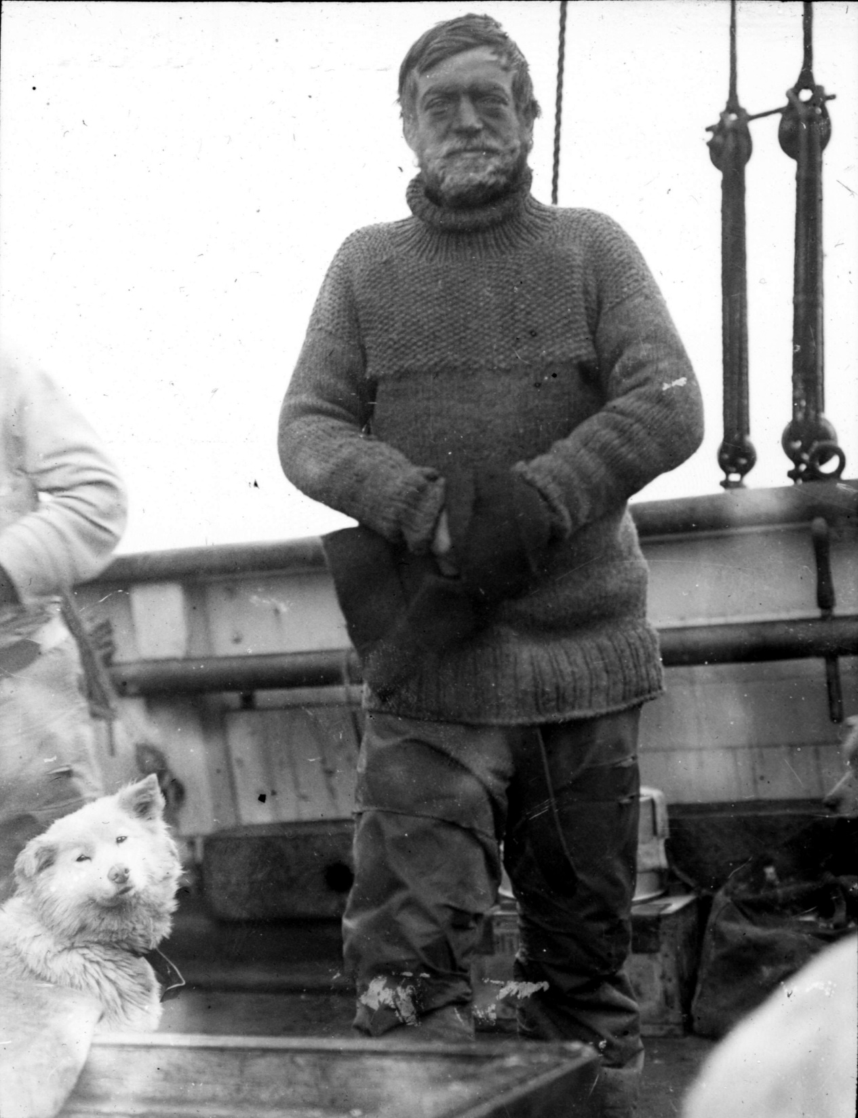
Ernest Shackleton 1874 - 1922
Born in Ireland on the 15th of February 1874 to an English family, one of 10 children, the family moved to London when Ernest was 10, he joined the merchant navy at 16.
Ernest Shackleton first went to Antarctica at the age of 27 in 1902 on Scott’s Discovery expedition. He was one of a party of 3 including Captain Scott who reached a then Farthest South coming within 530 miles of the South Pole. Shackleton suffered particularly from snow-blindness, frost bite and scurvy, and was invalided home early on the return to the expedition base.

Slide 3
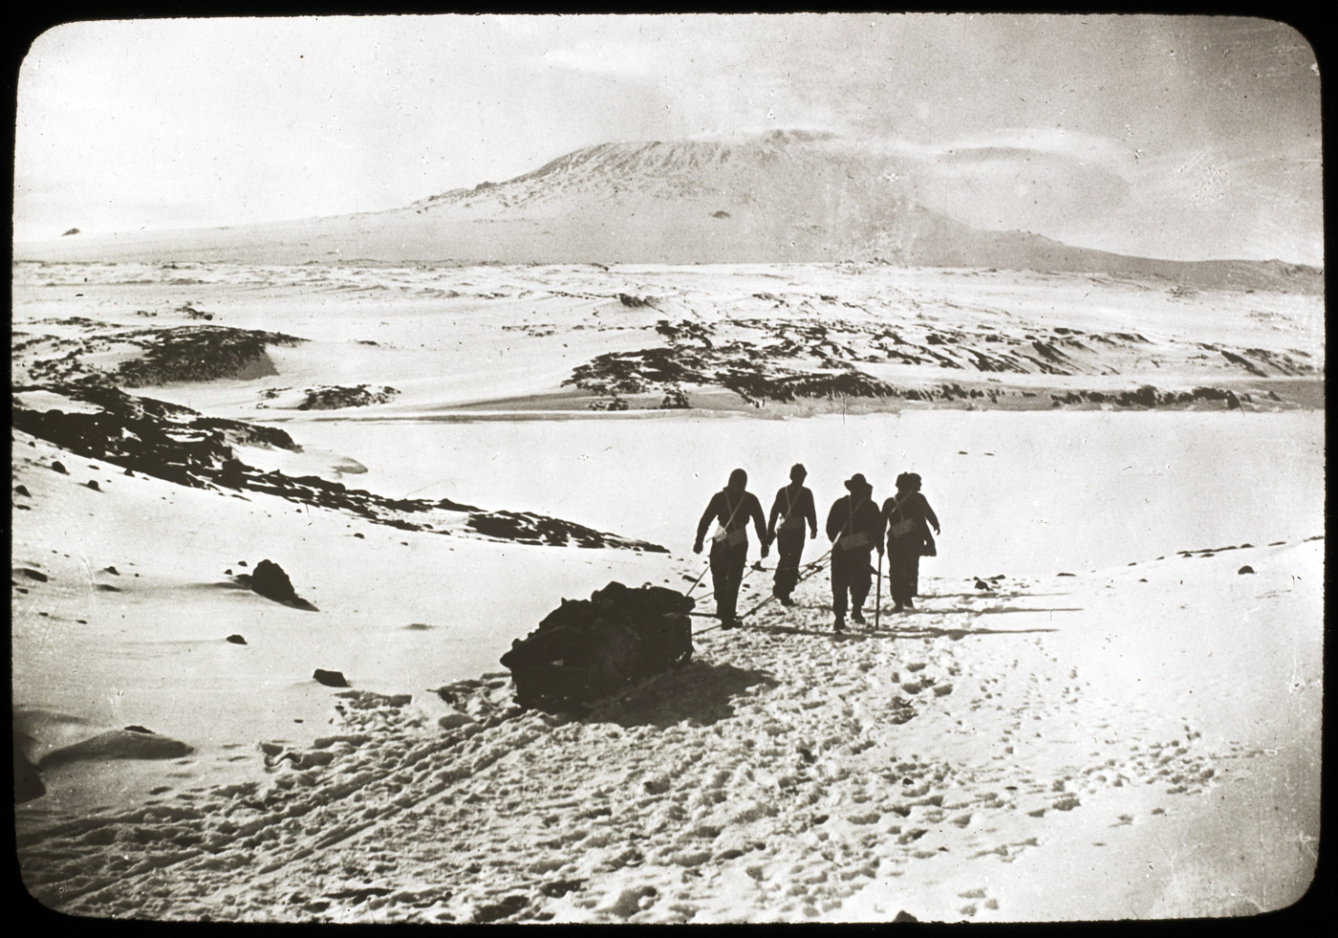
Manhauling during the Nimrod expedition attempt to reach the south pole, the second time Shackleton tried, Mount Erebus in the distance.
In 1908 on his own expedition on the ship Nimrod, Shackleton came to within 97 miles of the pole as part of a party of 4, another Farthest South.

Slide 4
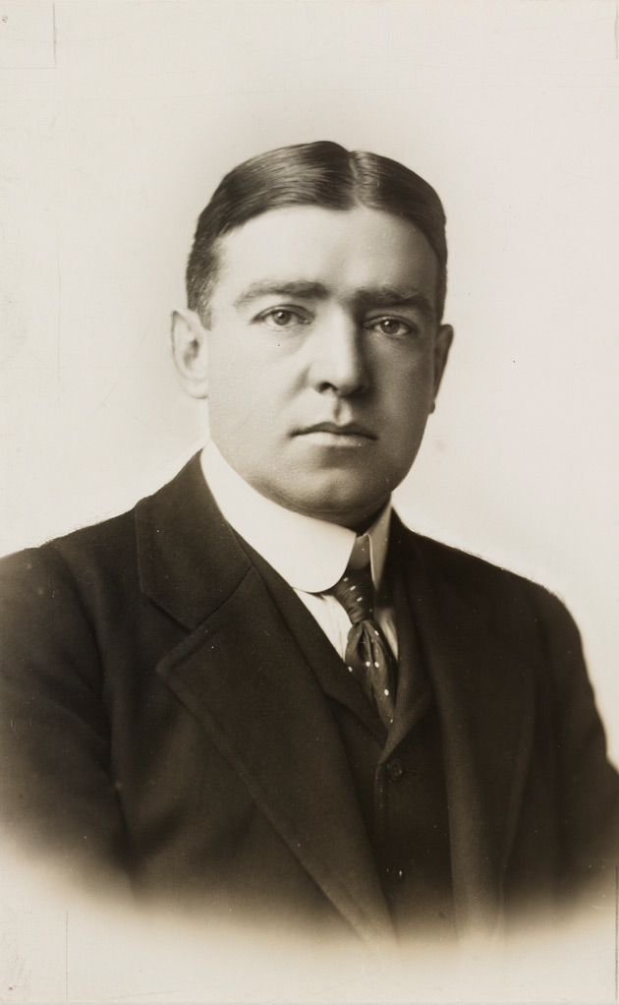
On his return from Antarctica and in between his Antarctic expeditions Shackleton tried to find other ways of making money, here are some things he attempted:
Applied for a commission to the Royal Navy - rejected.
Became a journalist - left quickly.
Become the Secretary of the Royal Scottish Geographical Society – briefly.
Stood for parliament – unsuccessfully.
Started a troop transport scheme - came to nothing.
Tried to promote a tobacco company - came to nothing.
Began a scheme selling stamps - came to nothing.
Tried to develop a Hungarian mine - came to nothing.

Slide 5
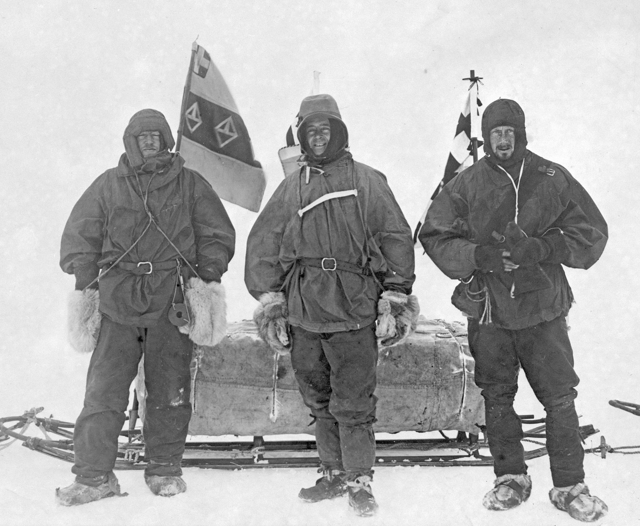
He did however receive many public honours including a knighthood. He was part of the first party to climb Mount Erebus. He was given an OBE in recognition of his efforts in the First World War. His most successful means of earning money was lecturing about his Antarctic trips. He was almost constantly in debt, particularly due to his expeditions. He was fortunate enough to have many of these debts written off by benefactors following his inability to repay them.

Slide 6
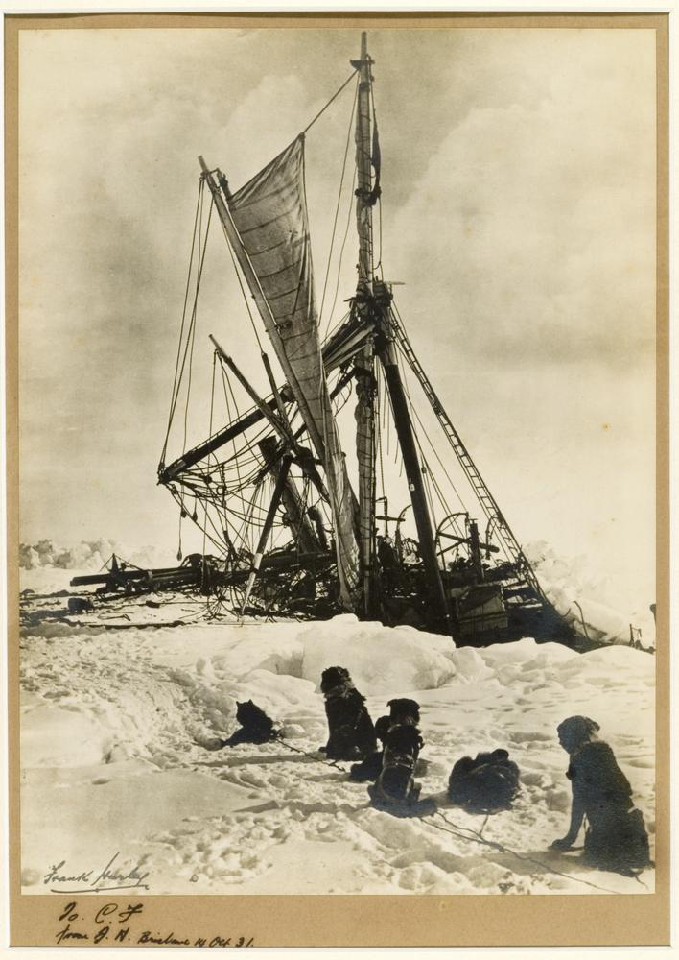
In 1914 Shackleton set out for Antarctica again, the south pole had been reached by the parties of Amundsen and Scott, so his intention was to cross the continent from one side to the other via the South Pole.
His ship, the Endurance, never even reached land in Antarctica, she was stuck in ice and then crushed, Shackleton and his crew faced a 19 month survival ordeal before they returned to safety. They were stranded out on unstable sea-ice with no means to communicate with the outside world and limited equipment and food.

Slide 7
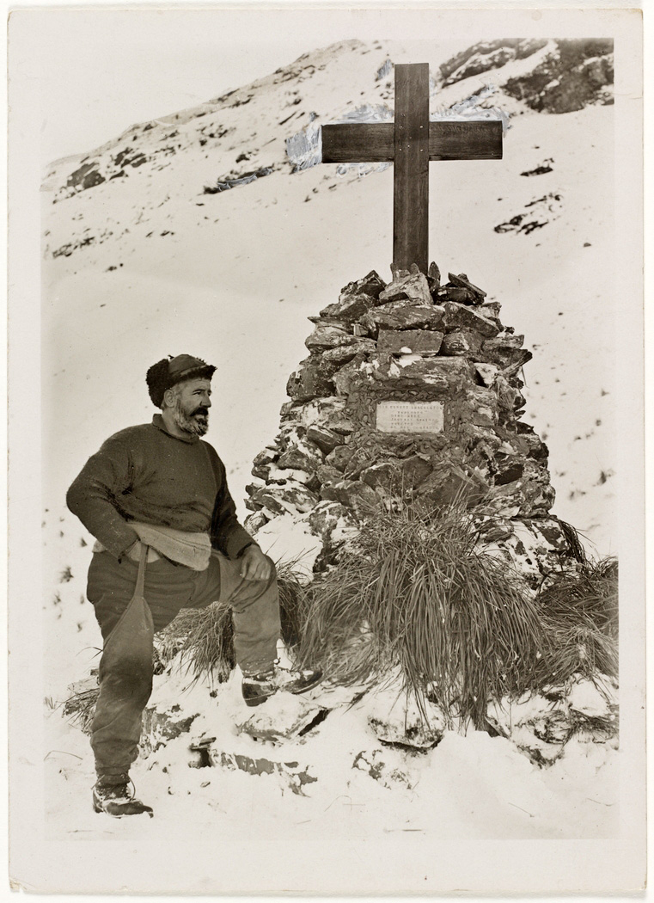
Shackleton died of a heart attack at the age of 47 in 1922 at the edge of Antarctica on South Georgia, at the very beginning of what would have been his 4th expedition. His death is considered to signify the end of the “Heroic Age” of Antarctic exploration that started in 1897. Despite a career where he never achieved most of his initial goals, Shackleton is considered to be one of the most successful leaders of all time and one of the greats of Polar Exploration.
Shackleton’s grave on South Georgia in 1922

Slide 8
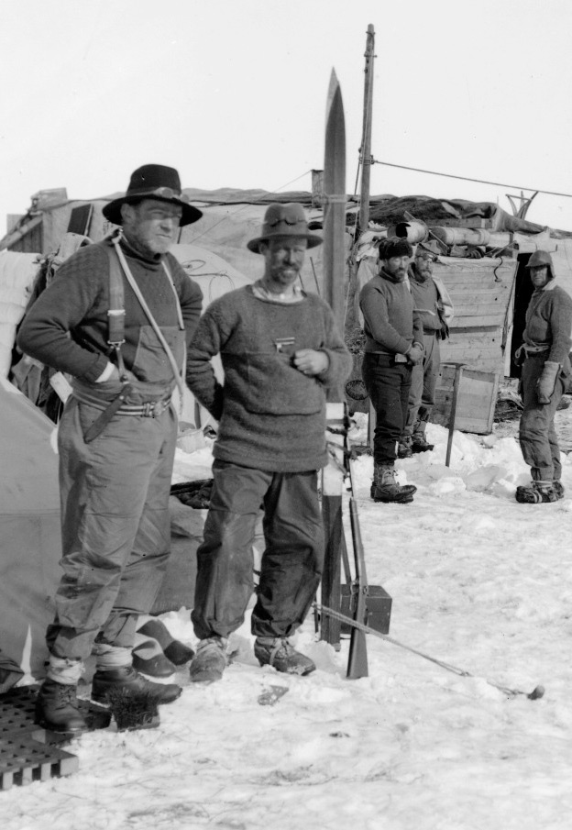
He was admired and most of all trusted by the men under his command having the “common touch”, able to converse, connect and have a joke with anyone. Above all, he led by example, he was ever eager and enthusiastic, sharing excitements and successes but keeping worries largely to himself.
Shackleton (l) with Frank Wild, camp on sea-ice after the Endurance was lost

Slide 9
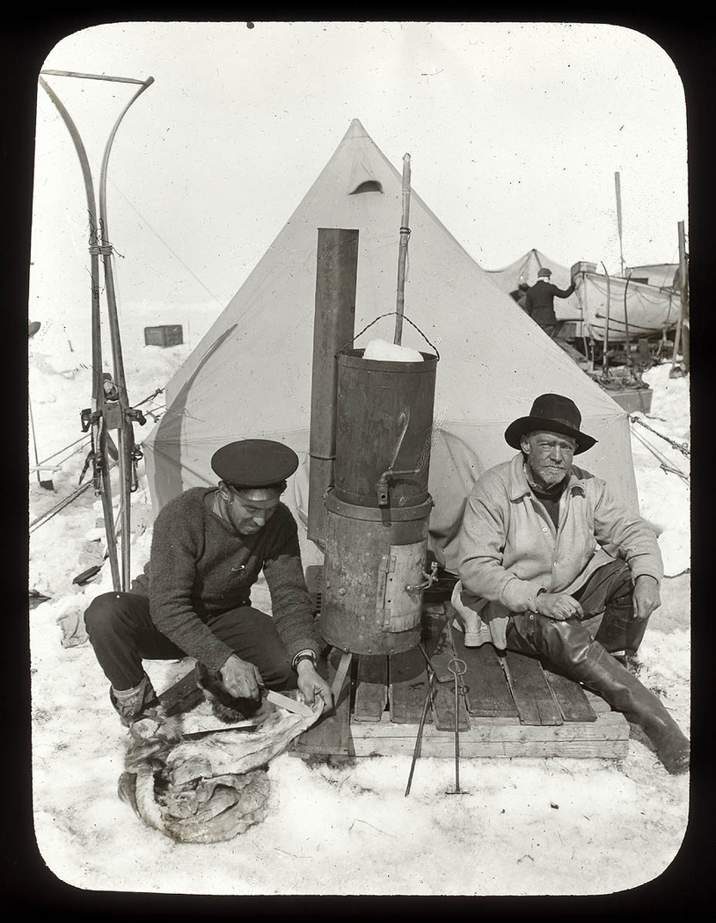
Shackleton’s style is a by-word for calm, reflective, effective leadership under pressure when faced with uncertainty and changing circumstances. The story of the Endurance expedition is of overcoming a series of obstacles any one of which is seemingly insurmountable. The crew were unanimous in their view that it was Shackleton who held things together and was instrumental in bringing them all back alive. This despite being faced with a widely varied team in temperament, ability and attitude to the situation they found themselves in.
Shackleton (r) with Frank Hurley, camp on sea-ice after the Endurance was lost

