Slide 1
Antarctica The Last Continent
Copyright: Material on these pages is copyright Paul Ward / CoolAntarctica.com or reproduced with permission from other copyright owners. It may be downloaded and printed for personal reference or public performance in an educational establishment as long as it is not for direct or indirect commercial use. It may be altered or modified, but not made publically available or transmitted to others in original or modified form without the written permission of Paul Ward / CoolAntarctica.com. Pictures by Alan Light, Drummond Small, Mike Usher, Paul Ward, Text by Paul Ward / CoolAntarctica.com
This copyright notice must appear wherever this material is used. Any queries please email

Slide 2
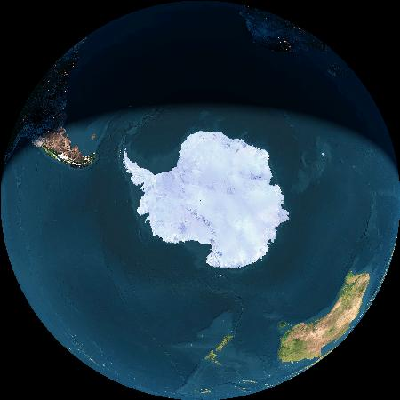
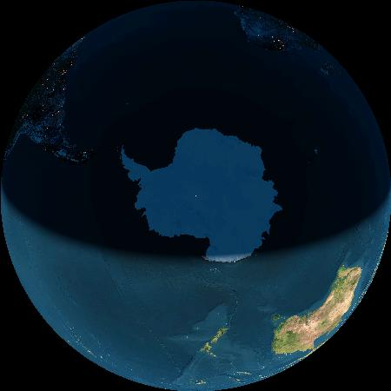
Antarctica covers the South Pole
Africa
South America
South Pole X
X
Australia and NZ
Midnight at the pole 21st December
Midday at the pole 21st June
The Living Earth, Inc. copyright 2006

Slide 3
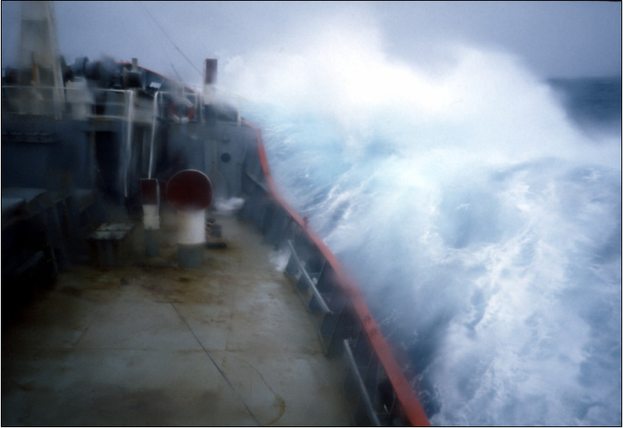
A common way to get to Antarctica is still by ship. This means crossing the “Drake’s Passage”, the narrow band of sea between Cape Horn and the Antarctic Peninsula. It is the roughest sea on Earth.

Slide 4
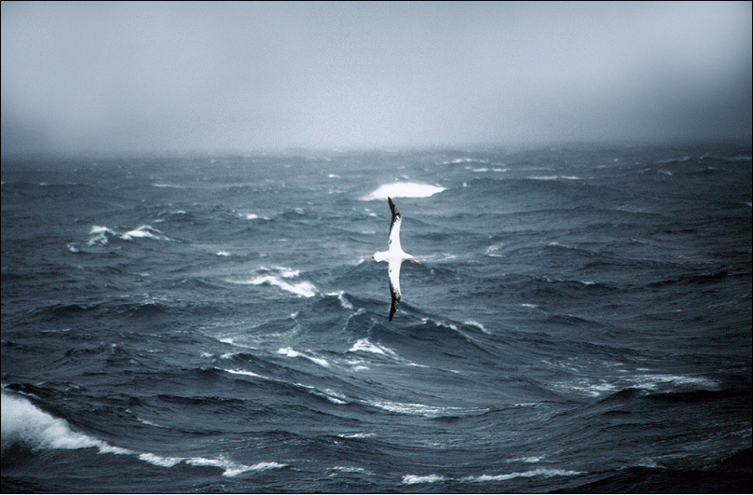
As your ship approaches Antarctica, you will be followed by albatrosses. This is a young Wandering Albatross – “The bird that made the wind to blow”. Wandering Albatross have the greatest wingspan of any birds at up to 3.5m.

Slide 5
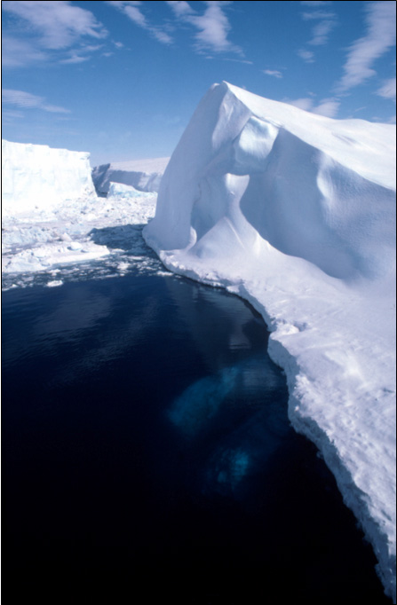
The first iceberg is like a doorway to the South.
You don’t know where you will encounter it and it will probably be a distant shape made out through mist under a grey sky.
Once seen, it signifies your passage into Antarctic waters and entry into a world quite different to any you have seen before.
Welcome to Antarctica.

Slide 6
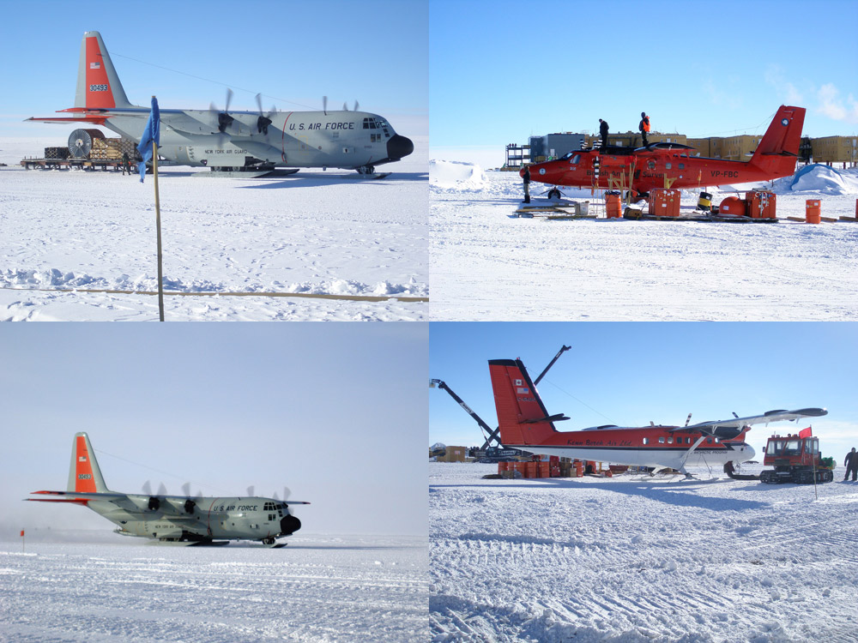
Increasing numbers of people now arrive in Antarctica by air. Ice runways are becoming more and more common and this is an increasingly regular form of transport for those on scientific bases. The planes land in South America or rather than spending weeks on board ships as was the case previously.

Slide 7
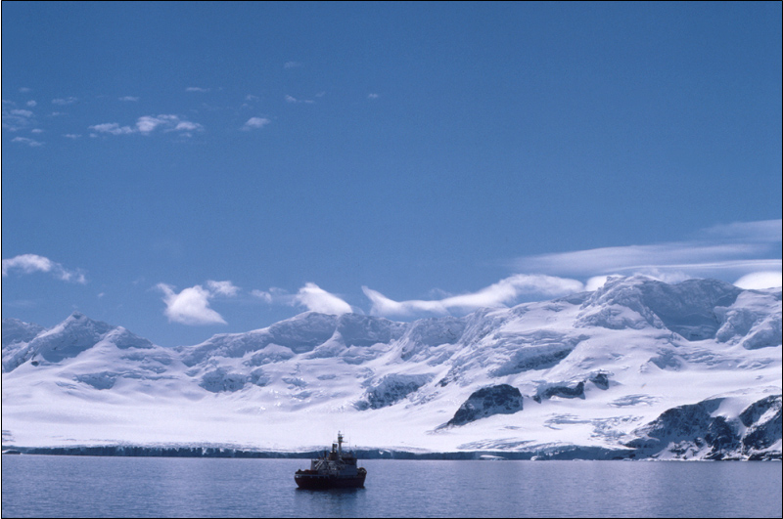
Once in Antarctica ships are the ideal way to get around. The continent and surrounding islands are either very mountainous and rugged broken up rock, or an endless unstable ice mass.

Slide 8
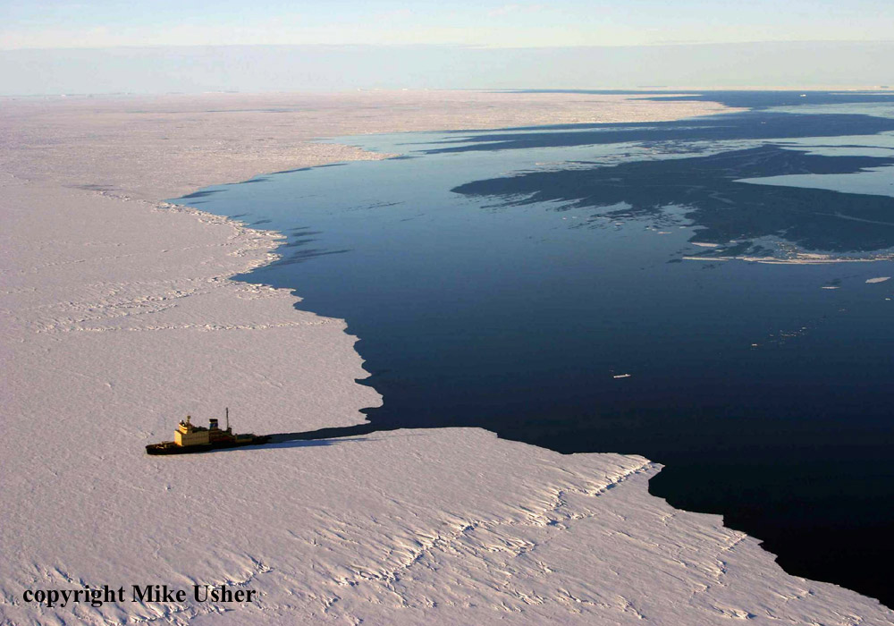
A Russian icebreaker leaves open water and starts to enter winter-formed ice in the Antarctic spring. Not all ships that visit Antarctica are icebreakers, but the great majority are ice strengthened. Coast-bound ice is common early in the season and being able to break through it means that cargo can be delivered without being so dependent on weather conditions.

Slide 9
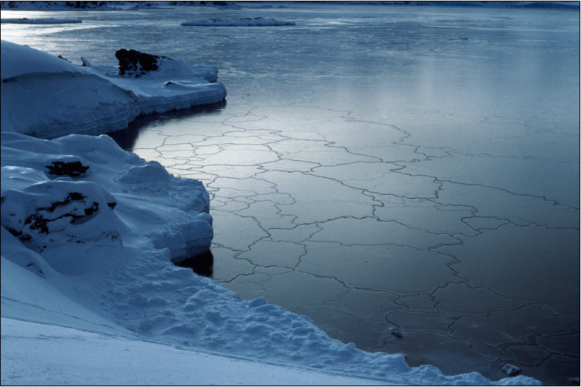
Sea-ice forming. At this stage it is maybe 1” / 2.5cm thick, but soft enough for you to push a finger through. The shapes are caused as the tide rises and falls, so pushing the edges of the plates over each other. The sea freezes quickly in calm cold conditions, it is the movement of the surface that prevents it freezing earlier.

Slide 10
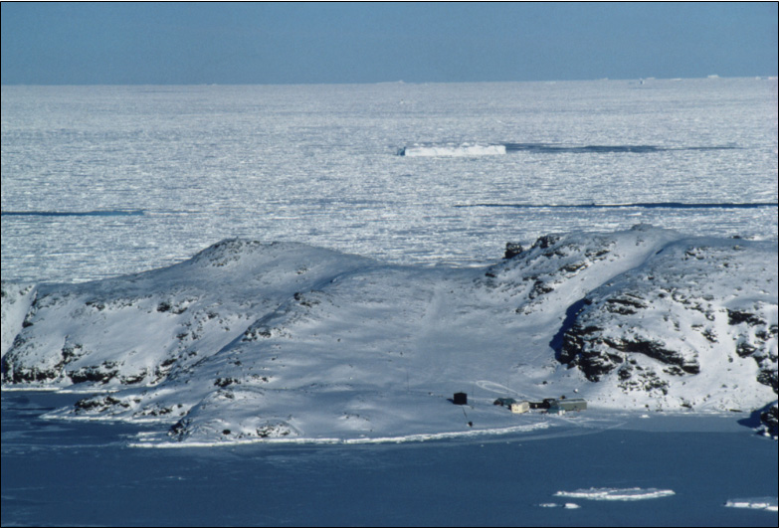
As the winter approaches, the only people left behind in Antarctica are scientists and support staff on research stations. About 1000 people in an area 1.5 times larger than the USA. Sea-ice doubles the area of Antarctica at this time and flights are very rarely attempted due to the darkness and weather conditions. This is Signy station (UK).

Slide 11
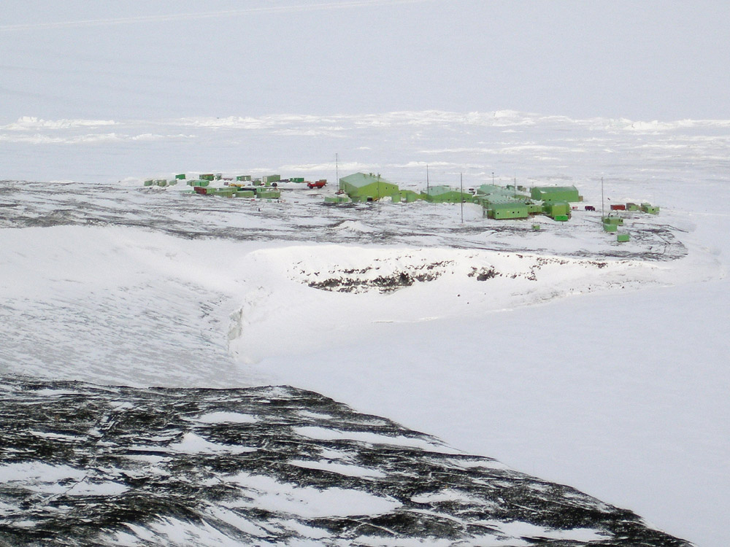
On the other side of Antarctica is the New Zealand Scott base. This is a fairly typical size for an Antarctic base, there are about 10 winterers and up to 85 in the summer months. The industrial-estate architecture is typical of Antarctic bases unfortunately.

Slide 12
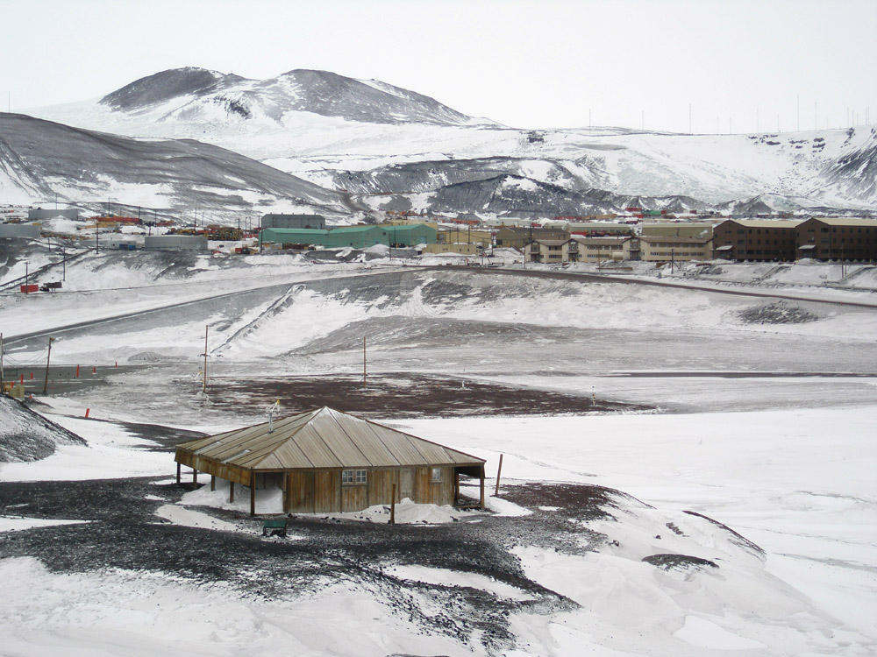
Antarctic bases old and new. In the foreground on Hut-Point McMurdo Sound is Scott’s 1904 hut from the Discovery expedition that housed 25 men, in the background is the modern McMurdo base that houses about 250 people in the winter and around 1000 in the summer – it is far and away the largest Antarctic Base.

Slide 13
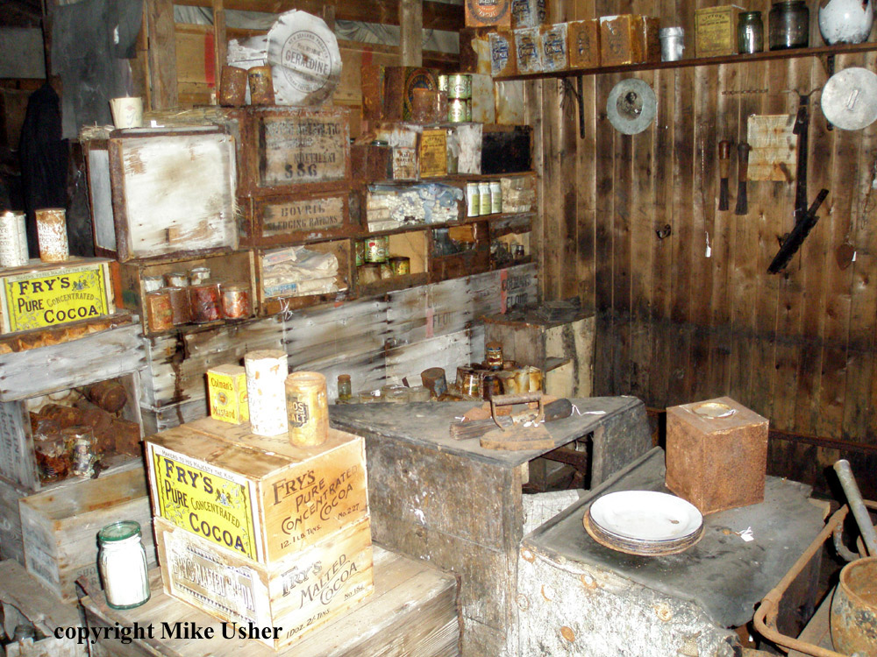
The interior of Scott’s hut is preserved like a time capsule. A combination of lack of visitors, cold temperatures and great respect shown by the few visitors there have been means that many items are exactly as they were when left over 100 years ago.

Slide 14
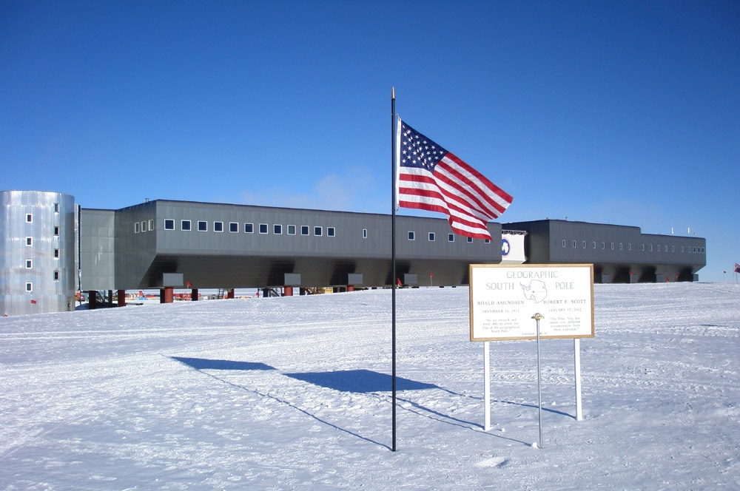
Amundsen-Scott Base at the South Pole. This base houses 75 over the winter and 250 in the summer. It is the third base in this location, the previous two were buried by accumulating snow and ice. Like other modern base designs built on ice, this is elevated on legs and can be raised to stay clear when the accumulation threatens to take over.

Slide 15
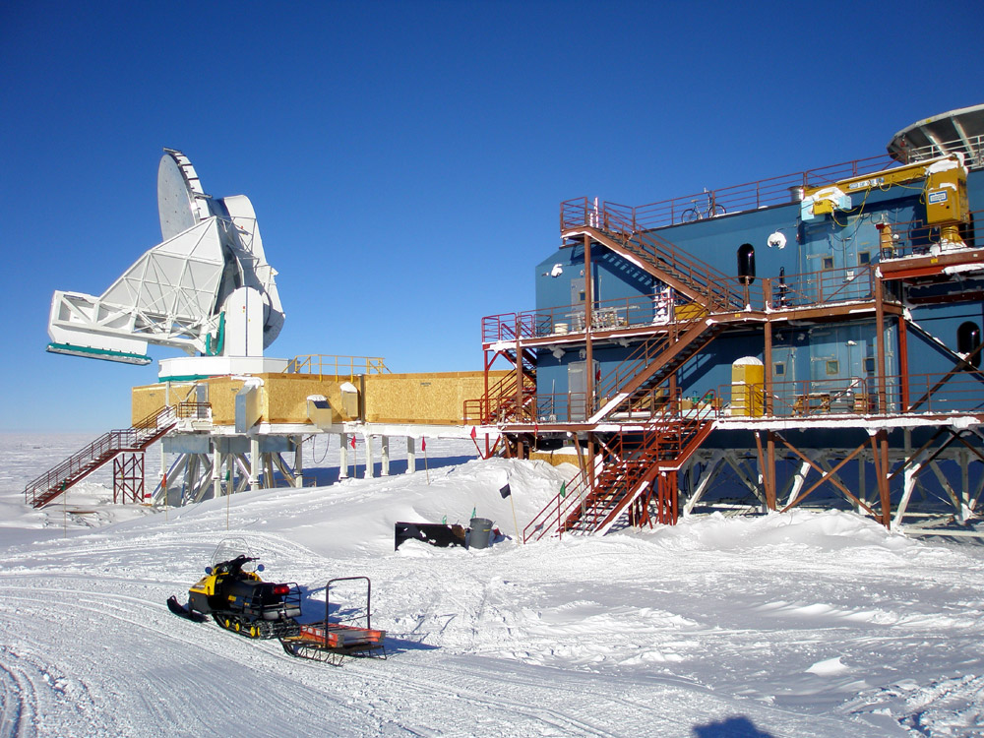
Science in Antarctica. Bases in Antarctica exist so that science can take place, there are a great number of different projects from the small to the large. This is a 10m telescope and laboratory at the South Pole.

Slide 16
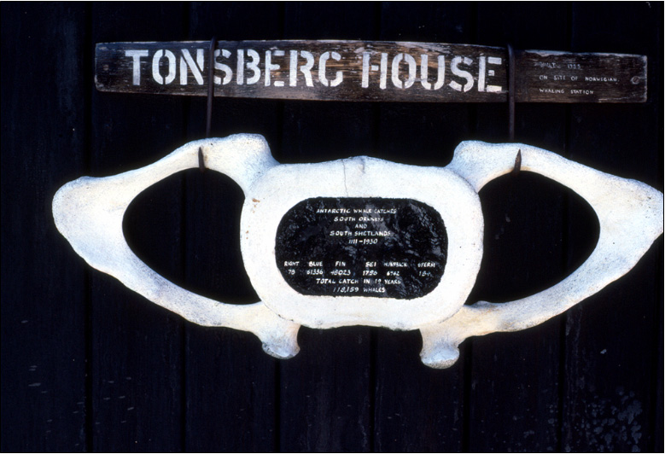
Early exploration of Antarctica was by whalers and sealers seeking to exploit the huge whale and seal populations – which they did to devastating effect. Seals have since largely recovered, but the great whales haven’t. This plaque is painted on a whale vertebra on an Antarctic base, it represents 118,159 whales killed between 1911 and 1930 – in just one part of Antarctica.

Slide 17
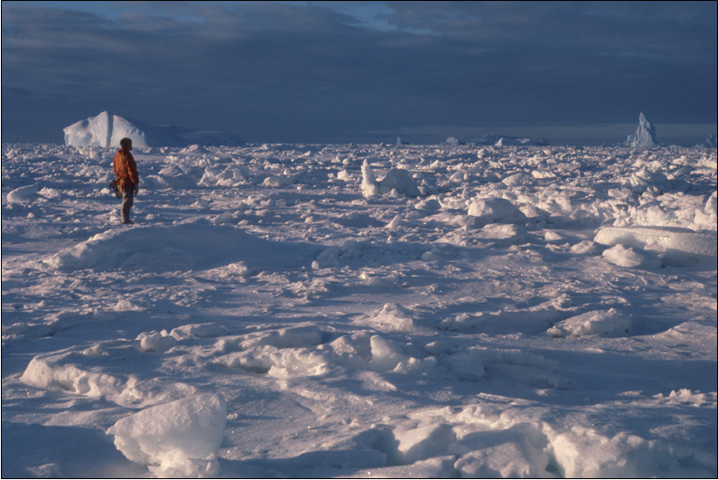
Pack-ice is “glued” together by the sea freezing between the pieces to give a solid surface. It is very rough and broken up however making a surface very difficult to travel over. Vehicles or people on skis have to stop-start constantly and change direction continually to find the best path.

Slide 18
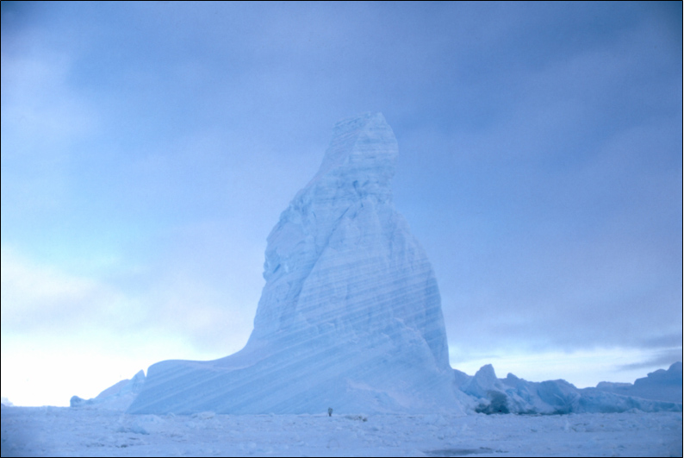
It is possible to walk across the sea-ice to frozen-in ice bergs. The stripes in the berg were formed when it was part of a glacier or ice-shelf and are a result of different temperature and snow conditions as the berg was being formed. Whiter bands have more air, they were formed in colder conditions. Bluer bands have less air and were formed in warmer conditions.

Slide 19
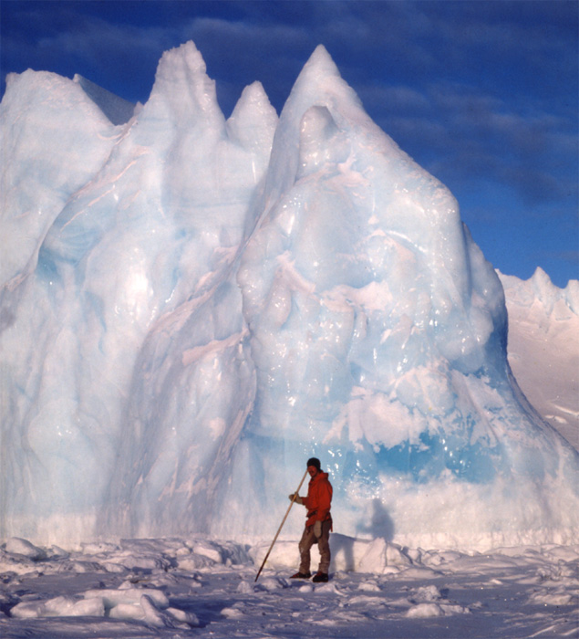
Standing next to even a small berg can be an un-nerving experience.
If the sun is out, the different colours warm up at different rates, clear regions can act like a lens warming up the interior.
The result is all kinds of creaks and bangs.
Add to this the sea-ice around it creaking as the tide rises or falls and it becomes an uncomfortable place to be.
There’s also the fact that you’re on ice not very thick and there’s 8-10 times more ice below your feet than you can see.

Slide 20
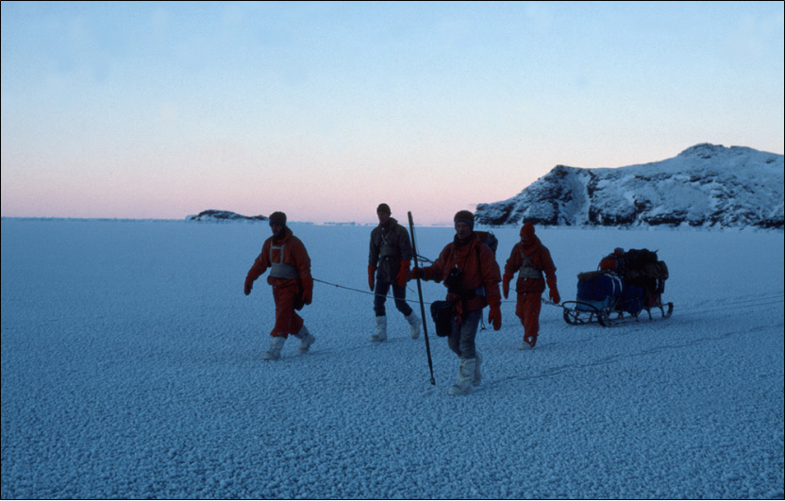
Fast-ice that forms in situ becomes hard and strong after many days of low temperatures and forms an excellent travelling surface. The long pole carried by one of these men is used to test the ice – more than 3 “thwacks” to get through and it’s safe to walk on, less than 3 and it’s re-trace your steps carefully.

Slide 21
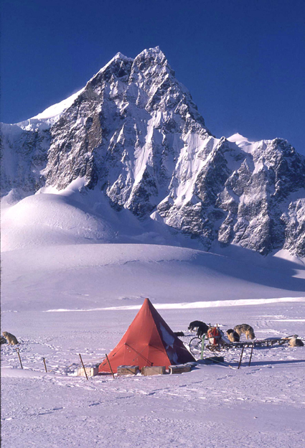
A field party in Antarctica has to be the purest way of experiencing the continent. Little can match doing this with sleds pulled by dogs. This is now a part of history never to be repeated as dogs were banished from Antarctica under the Antarctic Treaty in 1994. It was some 20 years before that however that dogs were used as a matter of necessity. Far less romantic internal combustion powered transport has been used for many years now.

Slide 22
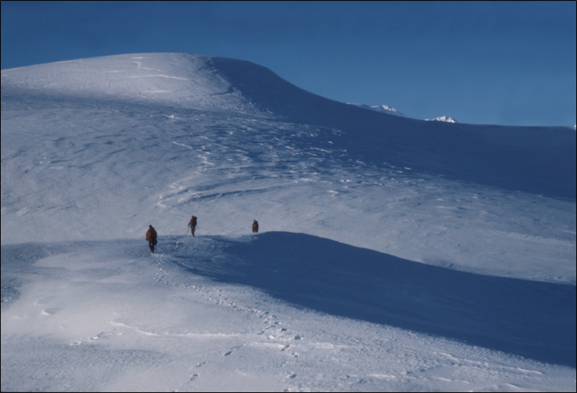
Crossing glaciers and ice fields is hazardous as they are often riddled with crevasses. These are cracks in the ice that form from top to bottom when the ice sheet direction changes or when it goes over an obstacle. Roping-up is required, so if one person goes down a crevasse, the others are able to rescue them.

Slide 23
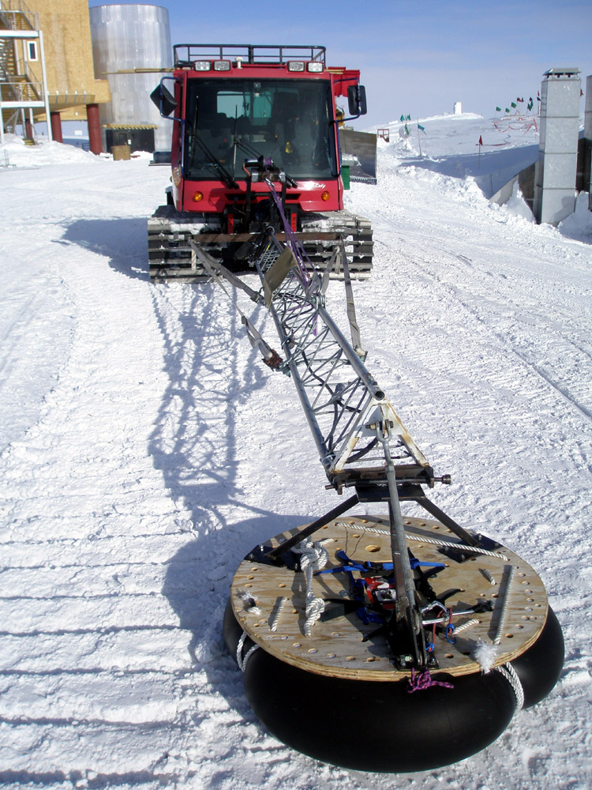
A Pisten Bully tracked vehicle with a crevasse probe. The probe itself is electronic, it is mounted on the end of the long arm, the wooden platform and inner tube allow it to ride ahead of the vehicle on the snow or ice. This vehicle will be the first one in a convoy going ahead of all the others and hopefully detecting crevasses and stopping before any vehicles are in danger.

Slide 24
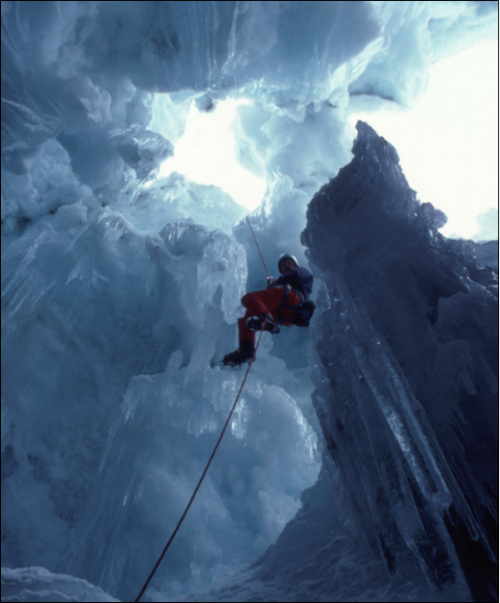
Investigating a crevasse – deliberately!
Crevasses are often covered over by a bridge of blown snow. Such bridges may be strong enough to support a vehicle or not strong enough to support a single man.
Care is needed in approaching them. Training to rescue yourself or others who may fall into a crevasse is a part of the preparation needed to travel around Antarctica overland and away from bases.

Slide 25
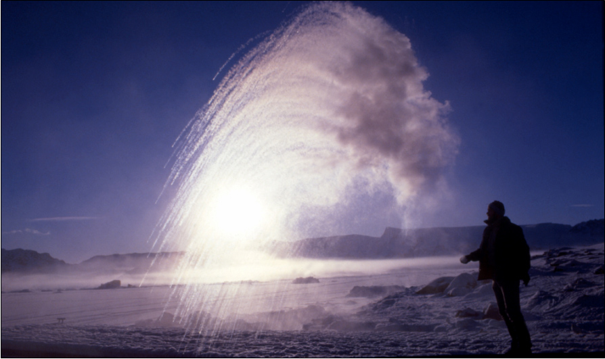
Here’s a fun thing to do on a cold day (-32°C here). Take out a flask of boiling water and a plastic cup. Pour the water into the cup and throw it into the air. As the +100°C water hits the cold air it instantly vapourises and drifts away. The streaks towards the bottom left are small pieces of ice, the rest just becomes gas.

Slide 26
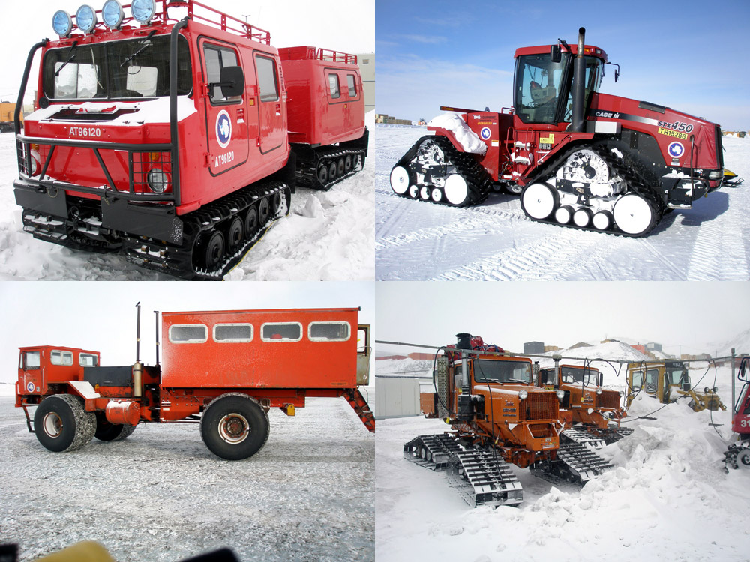
Antarctic land transport. Many vehicles are tracked including all that go away from the bases, wheeled transport is used in and around bases where conditions are predictable.

Slide 27
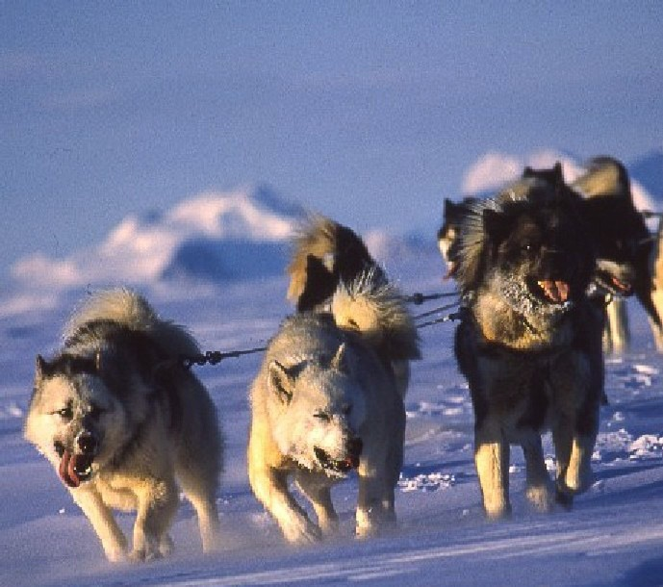
The original form of transport in Antarctica was dog-sled pulled by huskies. These animals helped to open up Antarctica and for many years were the only reliable form of transport until vehicles became reliable and trustworthy.

Slide 28
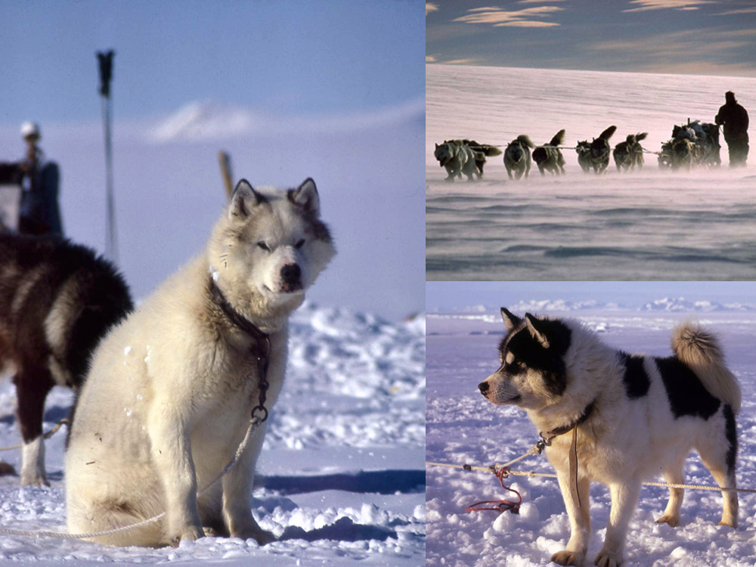
Strongly built, powerful and loyal until the end. The men who worked with huskies never forget the connection of man, dog and landscape, being part of the pack and working to a common goal in a challenging but ultimately hugely rewarding environment.

Slide 29
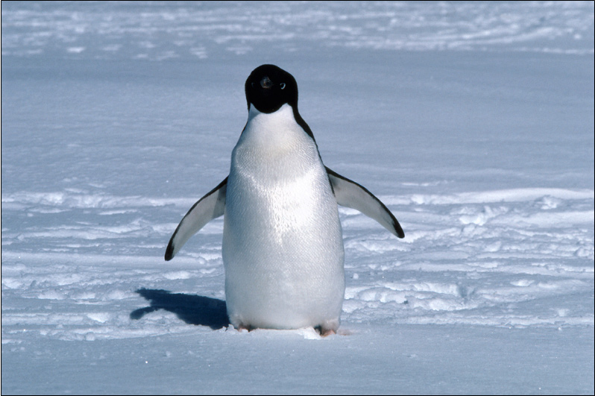
Antarctica is home to many millions of penguins, this one – an adélie is the commonest species found in Antarctica and an animal of the deep south. Here one is seen crossing the sea-ice to its nest site in early spring. As the season goes on the ice breaks up and it doesn’t have to go so far. It is around 70cm tall and about 5kg in weight.

Slide 30
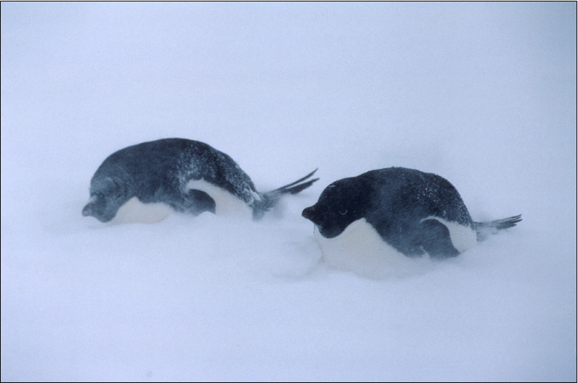
Early spring can still bring storms. These penguins are on their way to their nesting grounds and have to face out the weather. They head into the wind so their feathers are not ruffled to give the best insulation and pull themselves as short and squat as they can to reduce surface area to reduce lose heat loss.

Slide 31
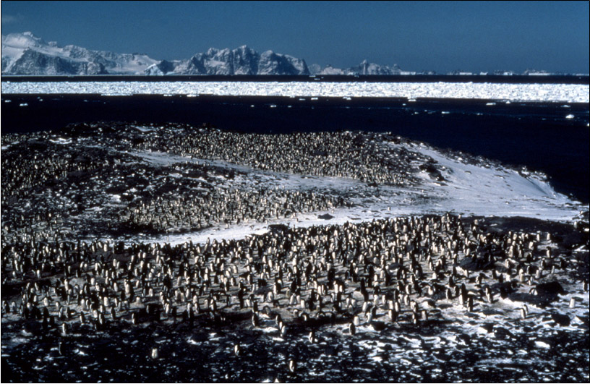
Nesting grounds start to fill up. This area has about half as many penguins as it will have eventually. Early arrivals get the best places that are raised to some degree, these are the least likely to get wet when it warms up and the snow melts. Note the pack-ice in the distance, this will break up as the season goes on.

Slide 32
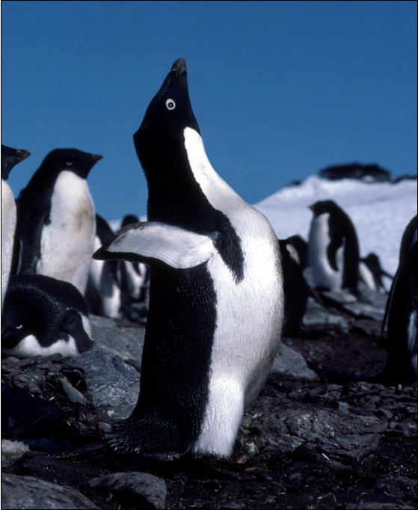
Like males the world over of almost any species, this male adélie penguin in the peak of condition advertises for a mate early in the breeding season.

Slide 33
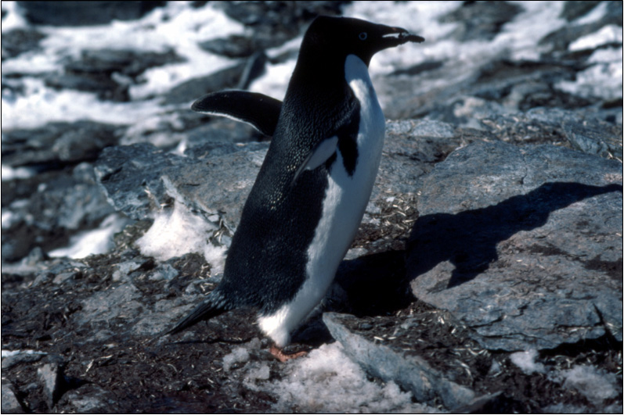
Once a mate has been found, nest-building begins in earnest. Penguin nests are amongst the least impressive of any birds nests consisting of just a circle of stones on the ground. As the supply of stones is fixed, they spend much of their time stealing them from each other over and over again.

Slide 34
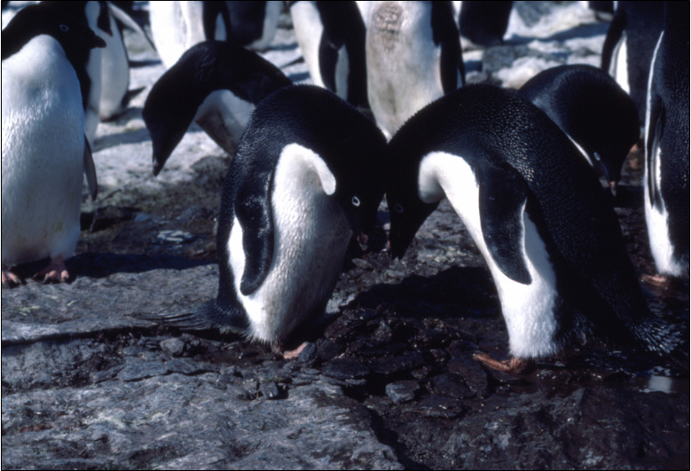
The proud parents to be by their magnificent nest – that’s it I’m afraid. This pair are in the process of a courting ritual. Starting low down they weave beaks together, getting higher and higher, eventually throwing their flippers back with a loud “awk, awk, awk” sound. It teaches them what their mate’s voice sounds like.

Slide 35
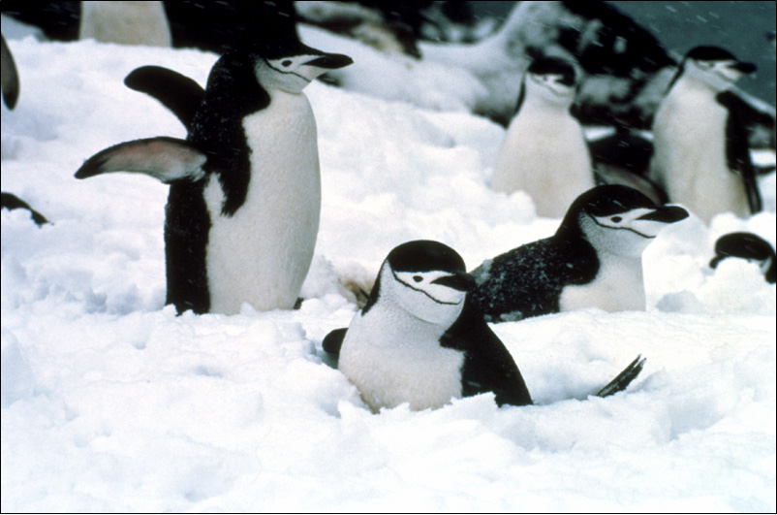
Snowfall at nesting time. It’s just around freezing point which can cause problems for penguins with eggs or chicks if the snow melts and floods the nest chilling the egg or chicks. Note the reddish colour under the flipper of the penguin to the left, a way of losing excess heat by diverting blood through the flippers.

Slide 36
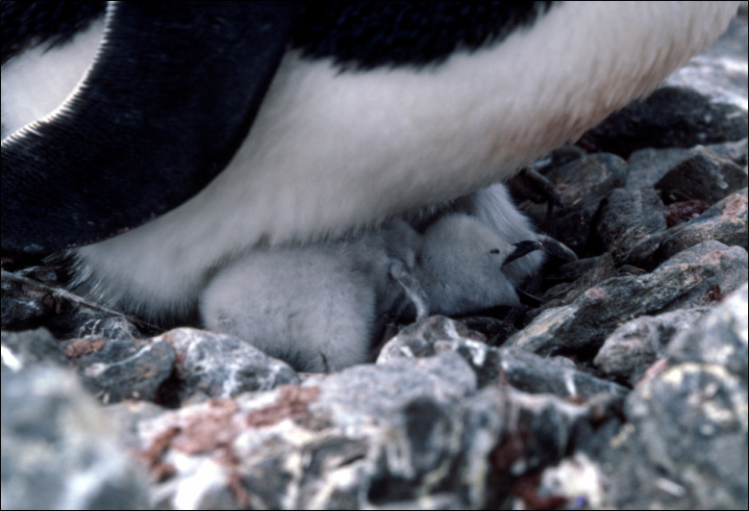
Eventually the eggs are hatched and the chicks born. Covered in fine down, they are always protected by one of the parents until they are large enough to be able to regulate their own temperature. Penguin chicks grow at a rapid rate being supplied with food by parents who take it turn to baby-sit or catch food.

Slide 37
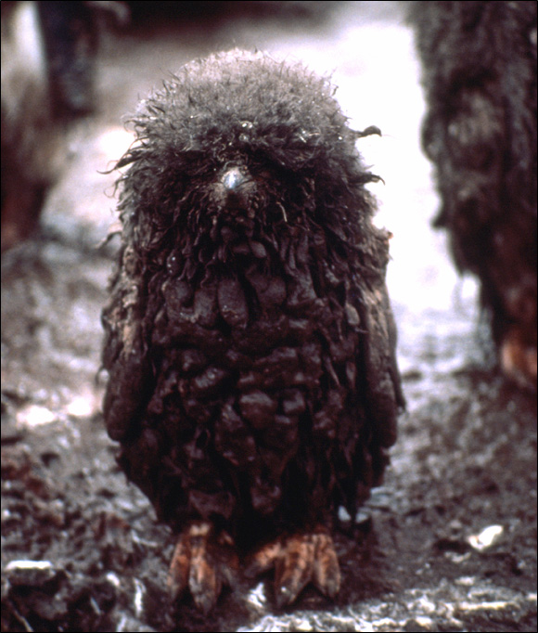
Like youngsters everywhere, penguin chicks get dirty and into trouble when their parents are away.
As the season progresses, so hygiene conditions deteriorate – I won’t go into details.
Some chicks get dirtier than others of course!
On a more serious note, getting so dirty can be dangerous as it decreases the effectiveness of the down to insulate the chick and unlike the adults, the chicks can’t go into the sea to wash themselves off.
Adélie Chicks don’t go into the sea until they have moulted their juvenile down and gained the adult feathers.

Slide 38
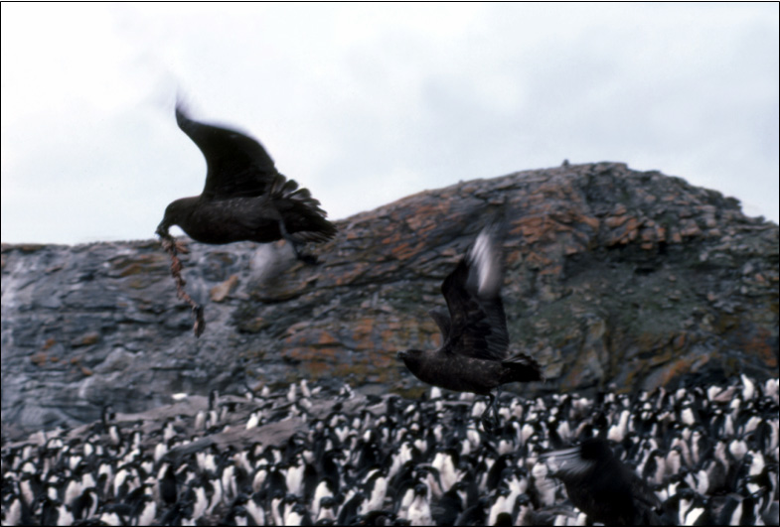
Penguin colonies are patrolled by predatory skuas looking out for unguarded eggs and unguarded or weakened chicks every ready to pounce. Despite their obvious presence and effect they have on the colony, they are only responsible for a small part of the overall mortality (death rate) of chicks.

Slide 39
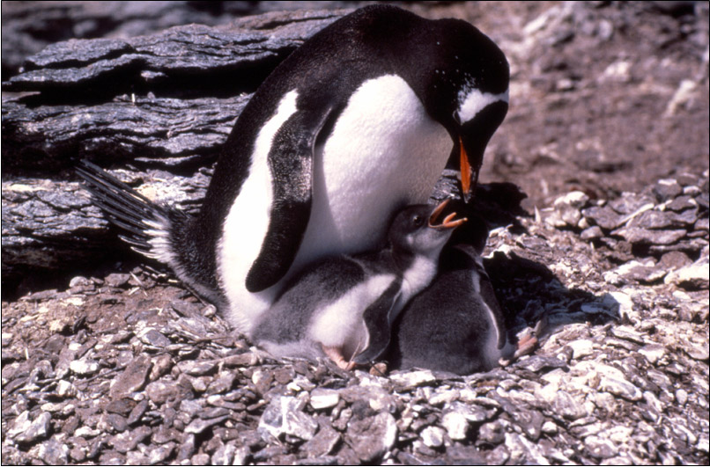
Gentoo penguin and chicks. One of the calmest and least aggressive of Antarctic penguins, there are two sub-species, this is the southern sub-species found down to the Antarctic Peninsula. The slightly larger northern sub-species is found mainly on the sub-Antarctic island of South Georgia.

Slide 40
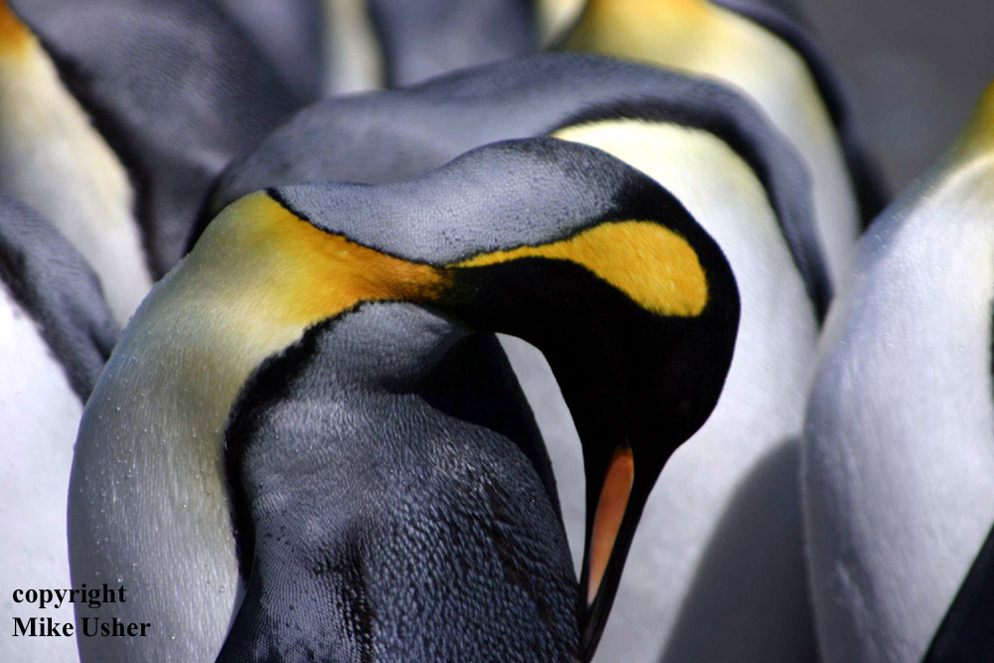
A King Penguin preening itself. These are the second largest of penguin species at nearly 1m tall and around 15kg. They are not birds of the ice however breeding on sub-Antarctic islands.

Slide 41
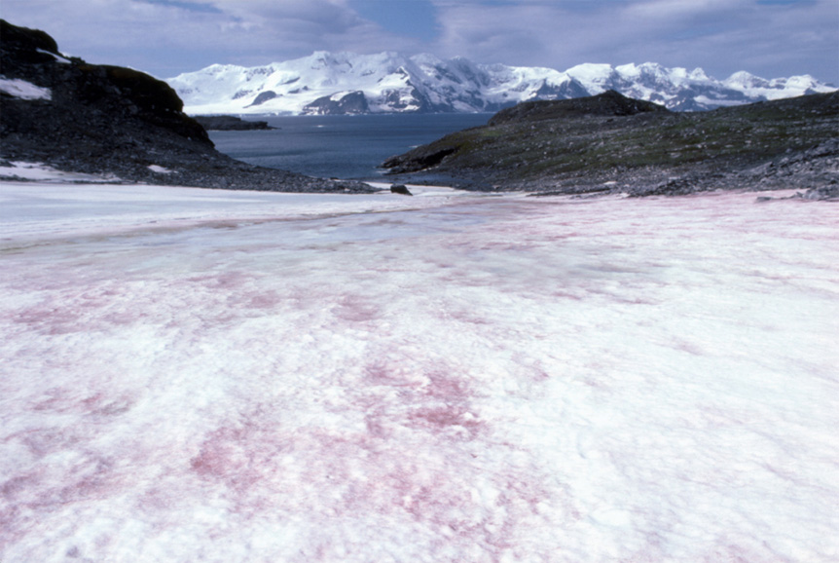
Raspberry ripple snow. Found in polar and mountainous regions in the spring as snow and ice begin to melt releasing stored nutrients, snow algae live in the top 10 inches or so of recent (the last year’s) snowfalls. Treading on the snow can release a faint smell of watermelon from the algae.

Slide 42
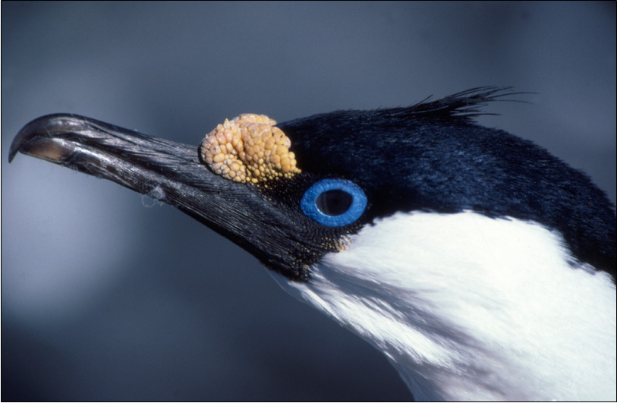
Blue eyed shag. A cormorant that nests in Antarctica down to the Peninsula. Blue eyed shags will not go far from open water, a fact that early Antarctic explorers soon learnt. When they are sighted by an entrapped ship it is a sign that an ice-free region is not far away.

Slide 43
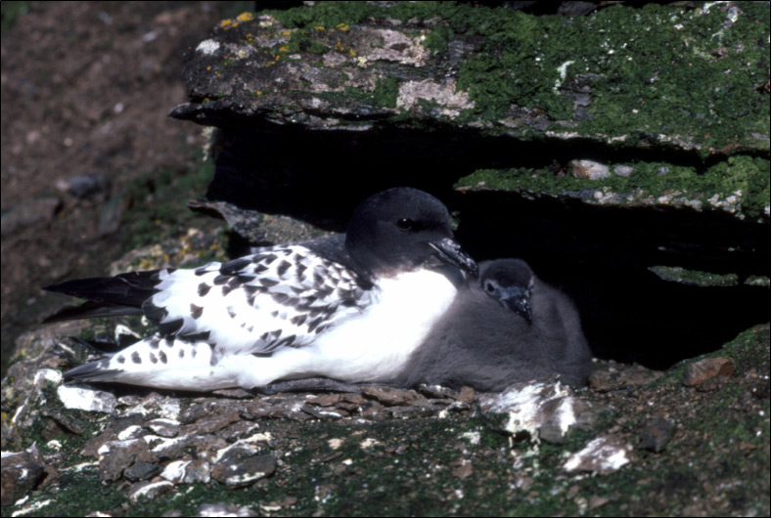
Cape Pigeons or Pintados are common small birds around Antarctic coasts. They are a similar size to common pigeons though are not closely related, being sea birds. They nest on ledges close to the sea.

Slide 44
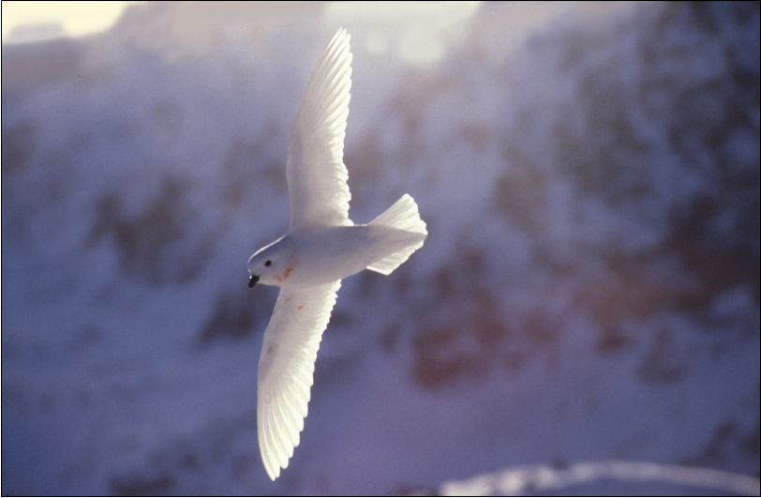
Snow petrel courtship takes place largely in the air as the female leads the males in an aerial ballet around the cliffs where they nest. The males task is to keep up. Unwelcome attention is responded to by some accurately sicked-up krill, the source of this males pink necklace.

Slide 45
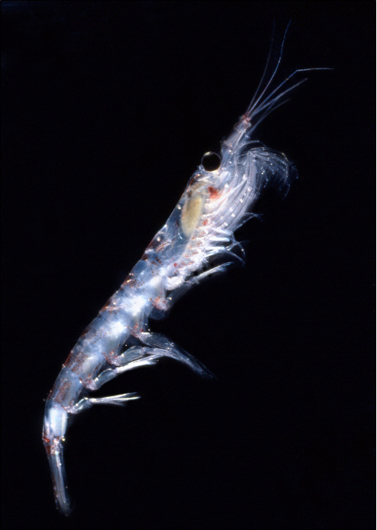
Krill are the engine that drives the Antarctic ecosystem. They are shrimp-like crustaceans about 4-5 cm (2 inches) long.
They feed on microscopic phytoplankton, floating plants that respond quickly to the rise in daylight in the spring. As krill are so large, they are available to nearly all Antarctic animals that are bigger than they are.
In other oceans, the animals that feed on phytoplankton tend to be smaller, so the ability to “tap” the food chain so close to the bottom is not available as it is in Antarctica.
Krill outweigh the human population of the earth by a factor of 2 or 3. Single swarms have been estimated as containing over 2 million tons of krill spread over 450 square kilometres.

Slide 46
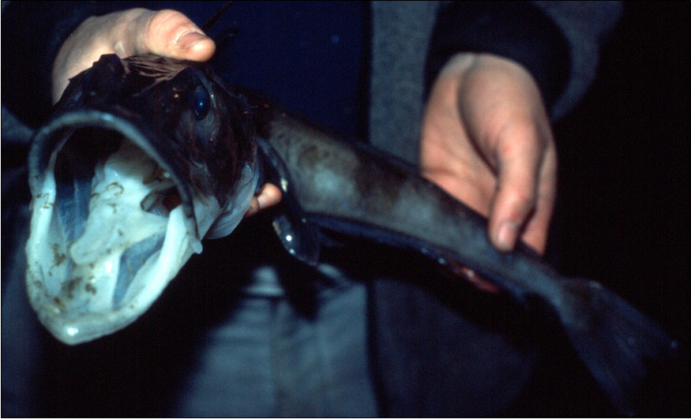
Antarctic fish are probably the best cold-adapted fish that the world has ever seen. They have lived at between -2°C and +2°C for 20-30 million years with virtually no transfer of species with any other seas. This ice fish has no red pigment in its blood to carry oxygen hence its white gills, low temperatures and high blood volume mean it is not required.

Slide 47
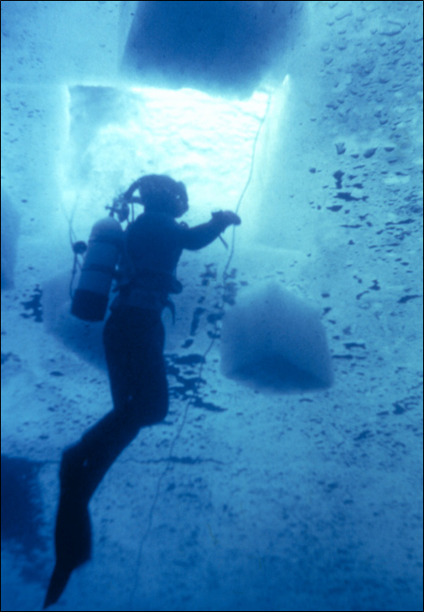
Dive holes can be made with a chain-saw with an especially long blade as has happened here.
A square hole is cut and then the floating ice cut into 4 pieces. These 4 pieces are then pushed down from the surface under the ice where they float up against the ice by their natural buoyancy. These 4 pieces can be seen around the diver.
Under-ice divers are always attached to the surface by a rope held by a line-man who lets the line out or pulls it in by a series of commands. In emergency, he can pull the divers manually back to the surface through the hole.

Slide 48
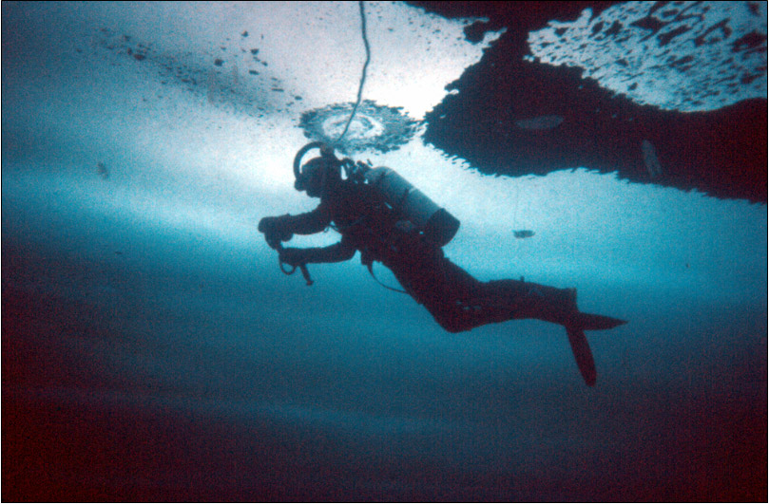
Diving in the winter is a special treat. As the sea-ice calms the sea movement down completely, any suspended sediment or particles just fall out of the water, so the visibility increases to crystal clarity. Diving under ice can be an ethereal experience. A fun thing you can do after a dive is to take your weight belt off and push yourself back under the ice, stand up and walk about upside down.

Slide 49
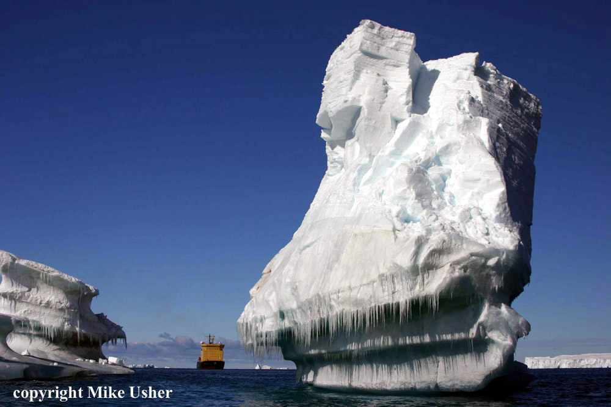
An iceberg having undergone much erosion and melting above and at the waterline. It’s not really that big, the ship is quite a long way behind.

Slide 50
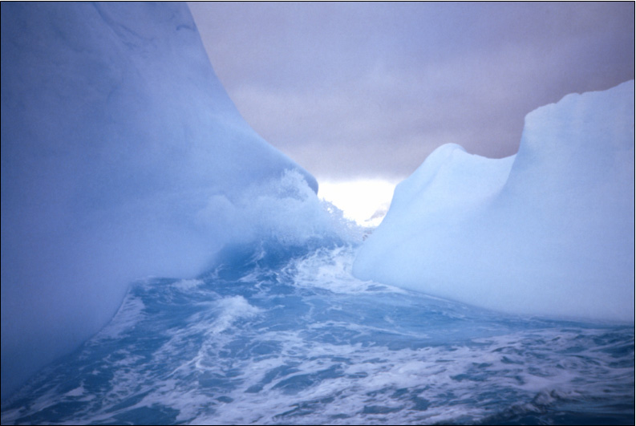
This was a particularly fascinating place. We sat in a small high-powered inflatable boat watching the waves rise and fall. As they rose, the gap in the berg was flooded, as they fell it was just ice. We debated whether or not to try and rush through on the rise. In the end discretion was probably the better part of valour.

Slide 51
Mountains that emerge from an expanse of ice are called “Nunataks” they are like islands that emerge from the ocean, except that in this case the ocean is one of snow and ice. Surprisingly such sterile environments can attract birds that nest on them despite being many miles from the sea and food.

Slide 52
Antarctica is very good at dramatic scenery. Perched atop this particular piece is the former Soviet Leningradskaya Station on a 1,000 foot nunatak in Oates Land. This base operated between 1971 and 1992, but was closed as it was too expensive and difficult to resupply. More recently there have been moves to possibly re-open it again.

Slide 53
One of the finest animals in the world (IMHO) – an Antarctic fur seal. These creatures can seem quite intimidating at first contact as they feign attacks and growl at you. When you’re more familiar and comfortable with their presence however, they can provide the best interactions possible with a truly wild animal.

Slide 54
Fur seals were brought very close to the edge of extinction by sealers n the 1800’s. They have recovered to a remarkable degree since however to the point where their numbers are threatening some fragile habitats in sub-Antarctica islands.

Slide 55
Newly born Weddell seal pups are officially some of the worlds cutest creatures, they flop about the ice in the early days after their birth, not able to co-ordinate their over-sized flippers before they grow into them. The mother arrived at the birth site some 10 days earlier pregnant and with enough resources of blubber and protein to double the 25kg (55lb) birth weight of a pup in 10 days.

Slide 56
Weddell seal milk is one of the richest produced by any mammal. It contains about 60% fat and is responsible for the rapid weight gain made by pups shortly after birth. The pups are weaned at around 7 weeks when they weigh about 110kg (242lb). Adults will weigh up to 400kg (880lb) and are up to 3m (10ft) long.

Slide 57
Displaying skua. Display is to, or for a mate or other skuas to establish a territory. Sometimes the birds do this as a pair, it is quite an impressive sight and the squawking can be heard some considerable distance away. Skuas will also do this if their nest is being approached by an unwanted visitor.

Slide 58
Antarctic terns nest on the Antarctic peninsula and islands. If an intruder gets too close to the nest site, they will dive-bomb. This picture, this is exactly what it seems like! The tern dives to great speed and lets out an ear-piercing call about 2 feet from your head that is perfectly timed to cause maximum panic!

Slide 59
A Giant Petrel, commonly known as a Geep, GP or to the old sealers as Stinkers - This name came from their habit, quite common amongst sea-birds, of vomiting on any one or thing that approached them and seemed to impose a threat. They build the traditional Antarctic nest of small stones, but always seem to manage quite an impressive pile of them in comparison to penguins for example.

Slide 60
An American sheathbill (also known as "Mutts") they're the garbage disposers of the Antarctic. They will eat just about anything that they can lay their beaks on. The only Antarctic bird species that don't have webbed feet and so are not able to fish for food like the others. They usually stay out of the path of the sea-ice and move north in the winter when the worst weather comes.

Slide 61
Elephant seals have clear “sexual dimorphism”, there is a big difference between males and females. Males, such as this individual can grow to be 8 times heavier than the females. They bear the scars of many fights with other males to gain supremacy over harems of females and become the “beachmaster”.

Slide 62
What is the biggest threat facing Antarctica?

Slide 63
To be ignored For people not to know about it. If you don’t know about something, how can you care for or protect it?

